Slide 1

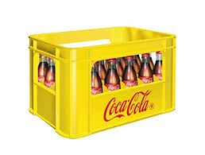
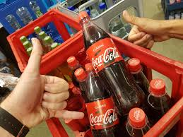

Returnables/ Refillables are a powerful tool to drive Category Leadership
Category Expansion!
  Footprint: Incidence & Frequency
  Affordability, Premiumness
  Loyalty
  Space: SOVI & Pantry
Sustainability
A one-of-a kind WIN-WIN-WIN-WIN System Proposition - WIN⁴
RETURNABLES
SUMMIT

Slide 2
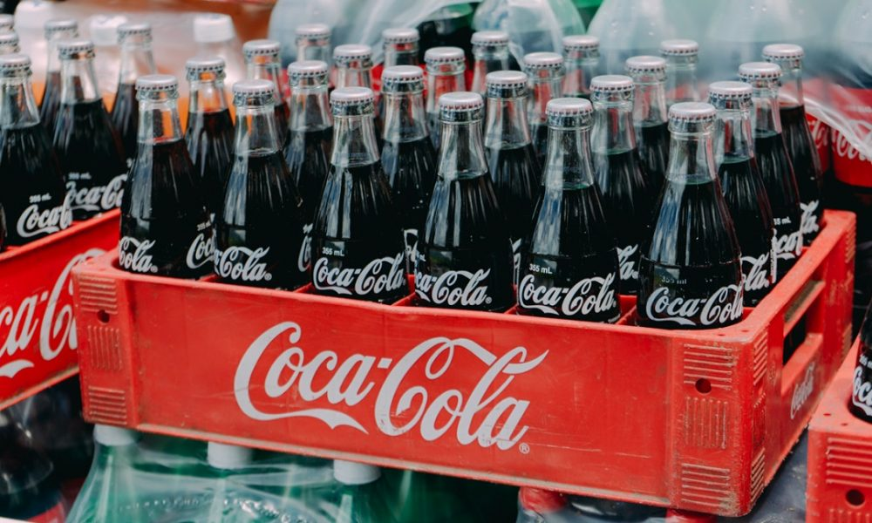
The business imperative
The returnables platform is a key enabler for accelerated incidence and share growth while delivering Affordability.

Slide 3



Returnables play a strategic Role in our Business
CONSUMER LOYALTY
COMPETITIVE TOOL
RETURNABLES DRIVE BUSINESS GROWTH
RETURNABLES ARE A DIFFERENTIATOR
Accessible across income levels
High entry barriers to replicate model
Recruitment - Builds consumer loyalty
Enables OBPPC Strategy – One Way
Attracts environmental
conscious consumers
Hedge against raw materials price fluctuations

Slide 4

What Are The Benefits And Barriers to Address in Returnables?
CONSUMER
Benefits:
Barriers to Address:
For the Experience
+38% tastes better
+27% is colder
+32% feels better in hand
+38% is high quality
Buying and storage
Requires planned purchase (42% forget bottle, 35% say storage is an issue)
Paying for the bottle
Doubts regarding cleaning process
Empty bottles may attract insects
For the Look
130 Index is “Unique”
130 Index is “Attractive packaging”
142 Index is “Make any drink look appealing”
+55% is sexy
Bottle
Breakable / Heavy
Dangerous to carry
Bottles with crowns with rust and not resealable
For the Pocket and the World
Offers Affordable options
Better for the environment
Source:Global Data, Coca-Cola Glass Packaging Consumer Report

Slide 5
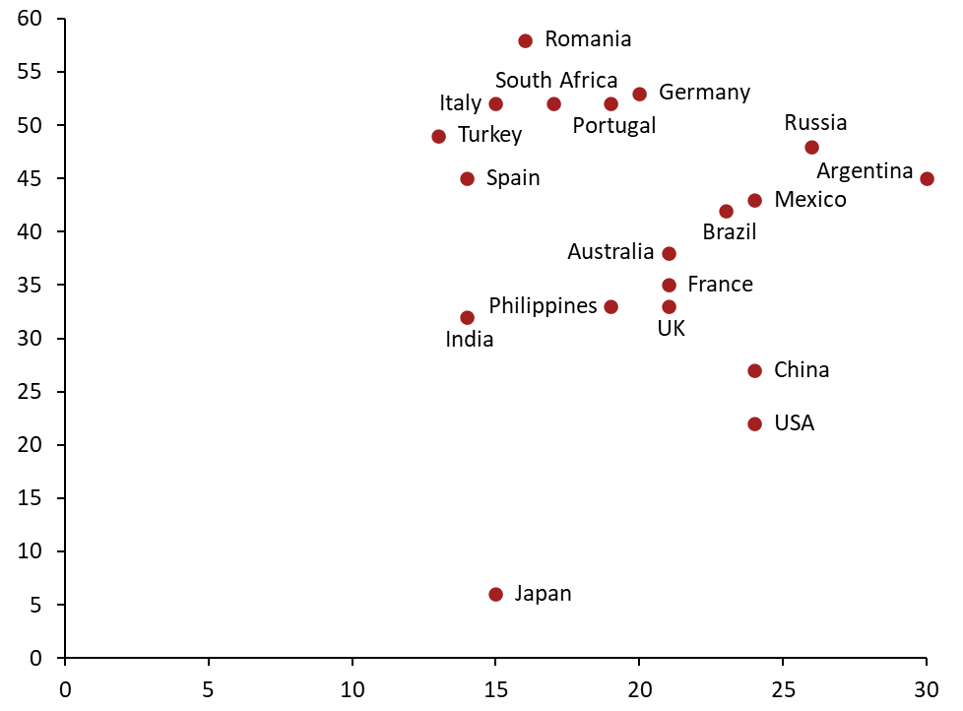
This holds true across markets as well as consumers in most markets clearly prefer the experience of glass over plastic (the second most preferred package)
Percentage of Consumers who prefer Glass vs Plastic by market
Percentage of Consumers
who prefer Glass
Glass = Plastic
Percentage of Consumers
who prefer Plastic
1. Survey Question: Which packaging do you favor across the following, Glass, Fountain, Plastic, Cans, Paper, Other
Source:Global Data

Slide 6
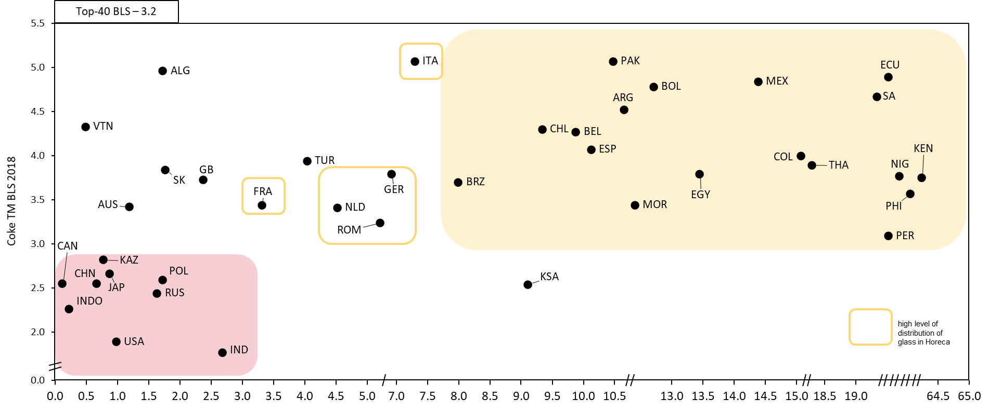
Brand equity (BLS), which is an indicator for recruitment, also has a directional relationship with % Glass mix for CCTM
Coke TM % Glass Mix Compared to Coke TM BLS Score
Coke TM BLS 2018
Top 40, Glass Mix Avg. (9.1%)
Coke TM Glass Mix YTD, 2021
Source: Glass mix GCS Volume YTD 2021, BLS from BGS 2018

Slide 7


What Are The Benefits And Barriers to Address in Returnables?
CUSTOMER
Benefits:
Barriers to Address:
Increased Loyalty due to same store visit Shoppers visit stores just because of these products Foster loyalty in periods of crisis/ economic downturns Important tool to increase frequency
Need space for empty crates and bottles Need to buy and manage bottles and crates Use of deposit schemes with their shoppers

Slide 8
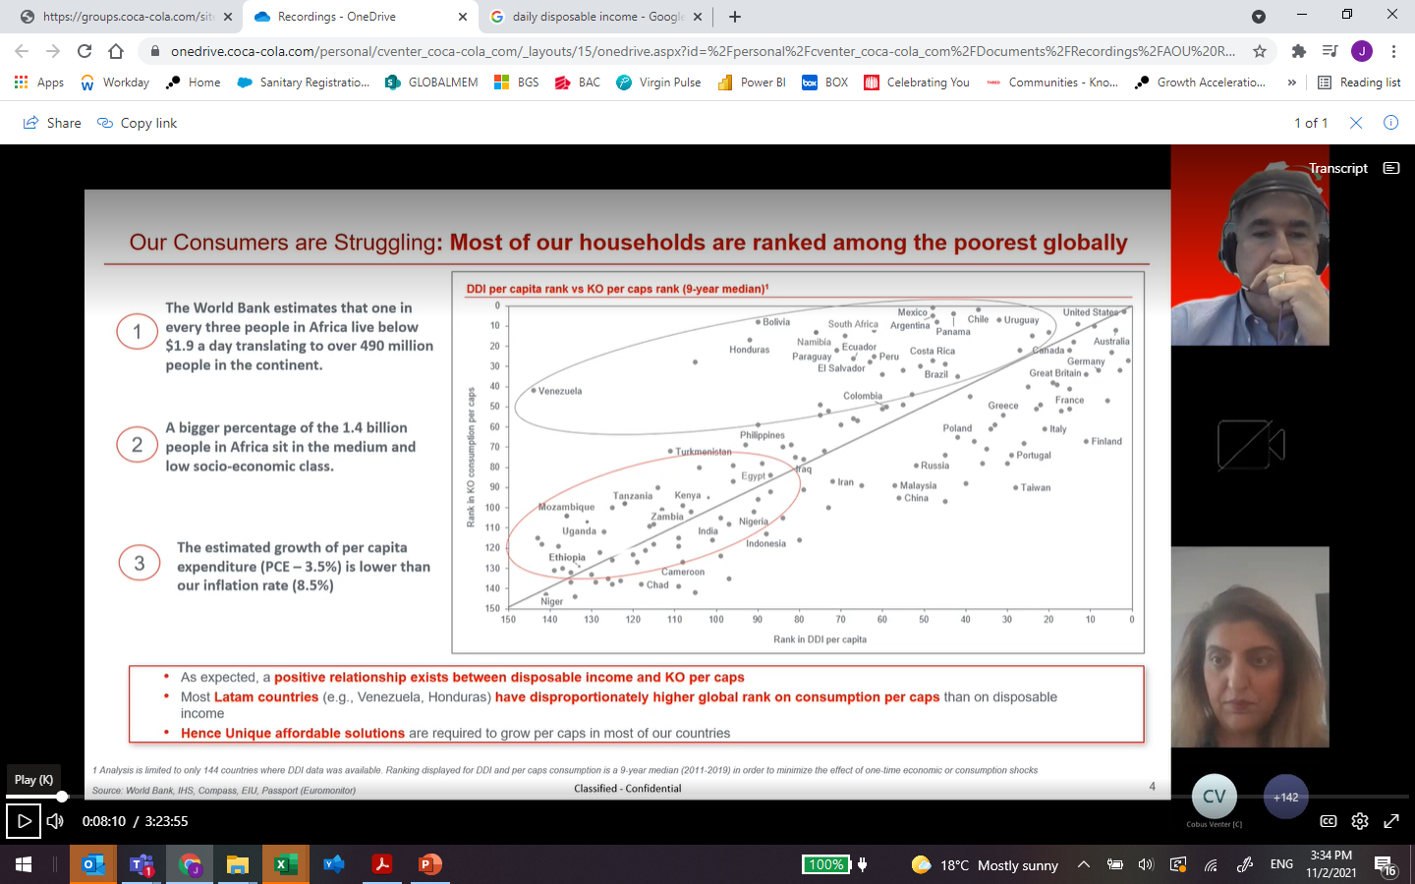
Relationship between Disposable income and KO Percaps
Uzbekistan

Slide 9


Yes…
…Returnables should be a Key Business Growth Pillar for our System…
…so, what should we do about it?

Slide 10


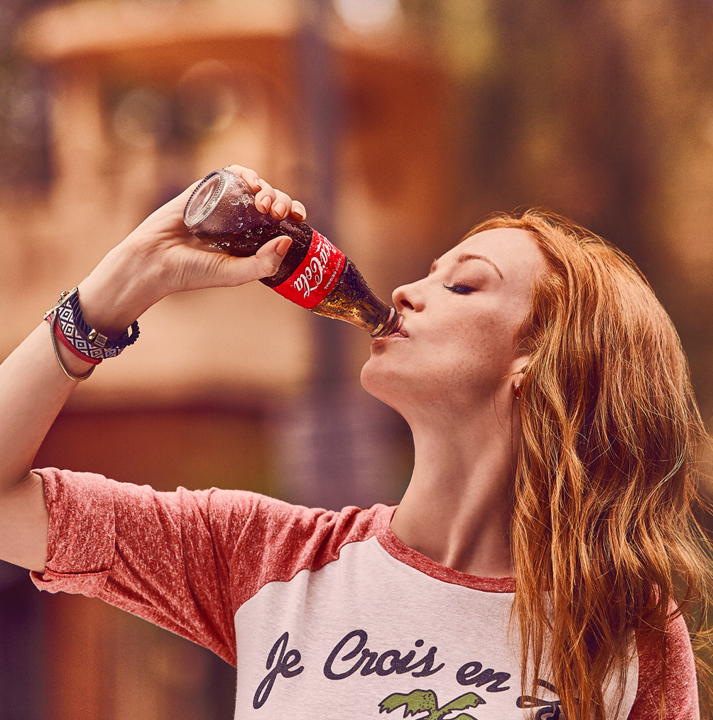

We should focus on our consumer Drivers
to turn them into our Returnability Edge
Powered by the brands´ Equity
Returnables’ EDGE
Affordability
Smart shopper
Best consumption experience
Better for the environment
“Iconic” experience
Relevance
Uniqueness
Returnables Edge is not only about the bottle
…but about the whole value proposition, powered by the Brand’s attributes and Equity, which makes it appealing and relevant to consumers.

Slide 11



Contributing in all relevant dimensions
in our 3 A’s model
Availability
Affordability
Affinity
Cold and ready to enjoy (drinking experience)
Competitive price
Best value equation
Smart shopper
Environmental care
Frequency enabler
Returnability!

Slide 12
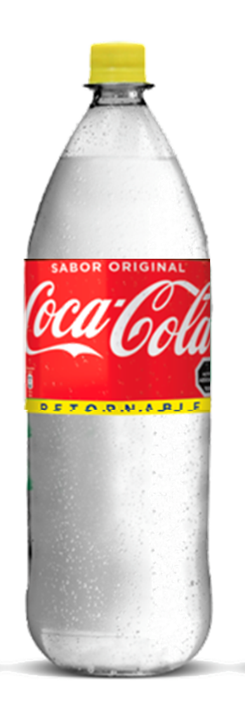
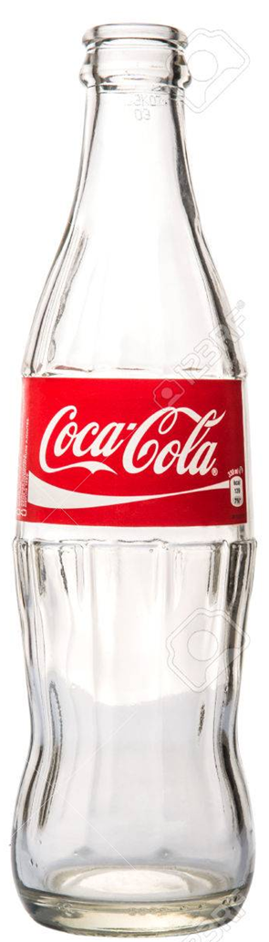



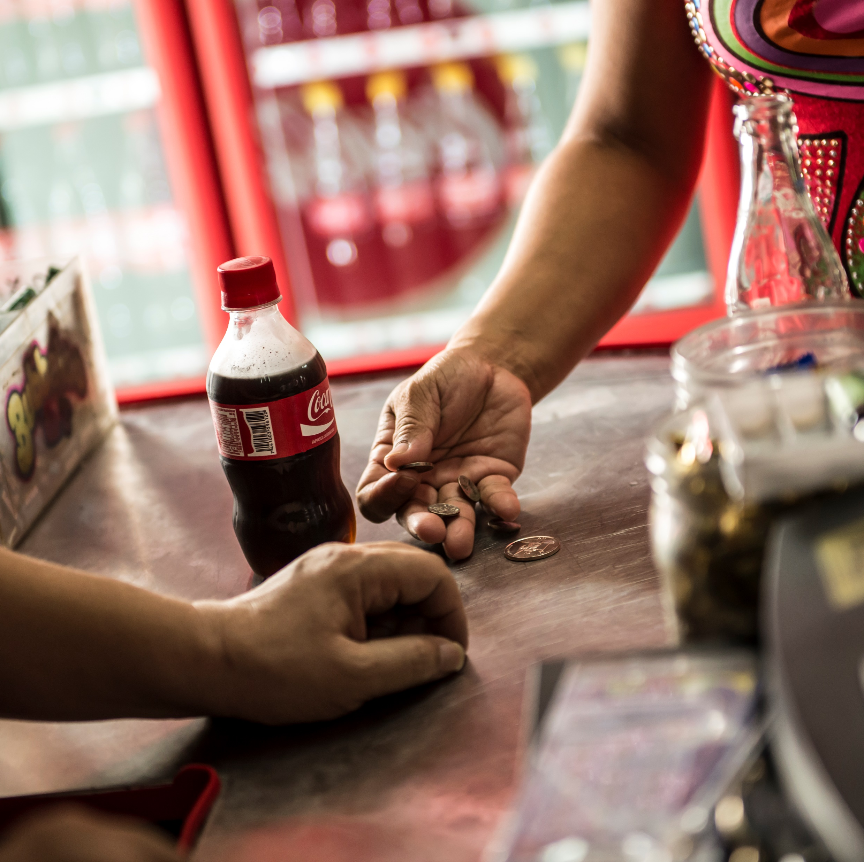
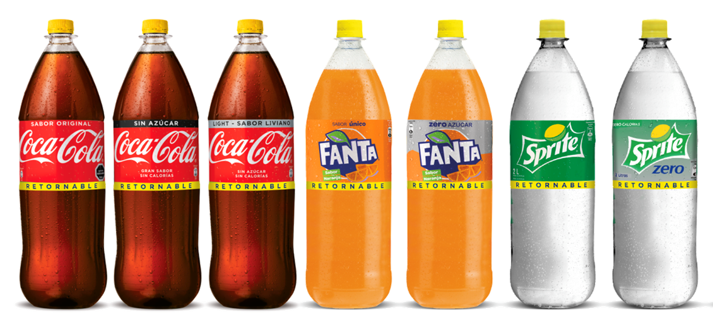




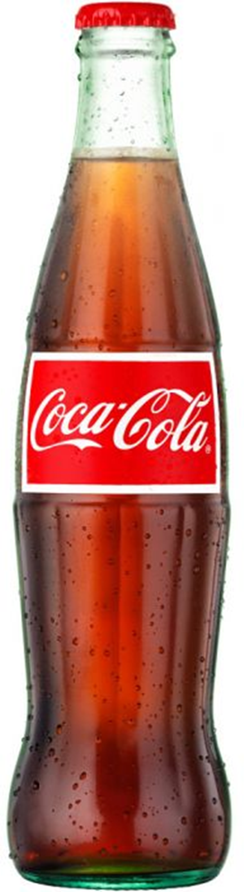
as a Subscription Model
Leveraging Returnability
It’s a Subscription Economy!
Customers
+
Recurring revenue flow
Consumers
Returnable bottle as the enabler or “access key” to our portfolio.

Slide 13





The Returnability virtuous cycle…
Winning
Portfolio
Holistic OBPPC (affordability + value)
Universal bottle
Full Engagement
Profitable
Consumer Base
Growth
Outstanding
Experience
BuilD & reinforce the returnable habit through fully integrated 360 Plans for all stakeholders
State of the art Execution
Appealing and call to action Communication
Consumer
Enablers, Processes, KPI´s & Continuous investment

Slide 14
Holistic OBPPC (affordability+value)
Universal bottle
Winning
Portfolio

Slide 15

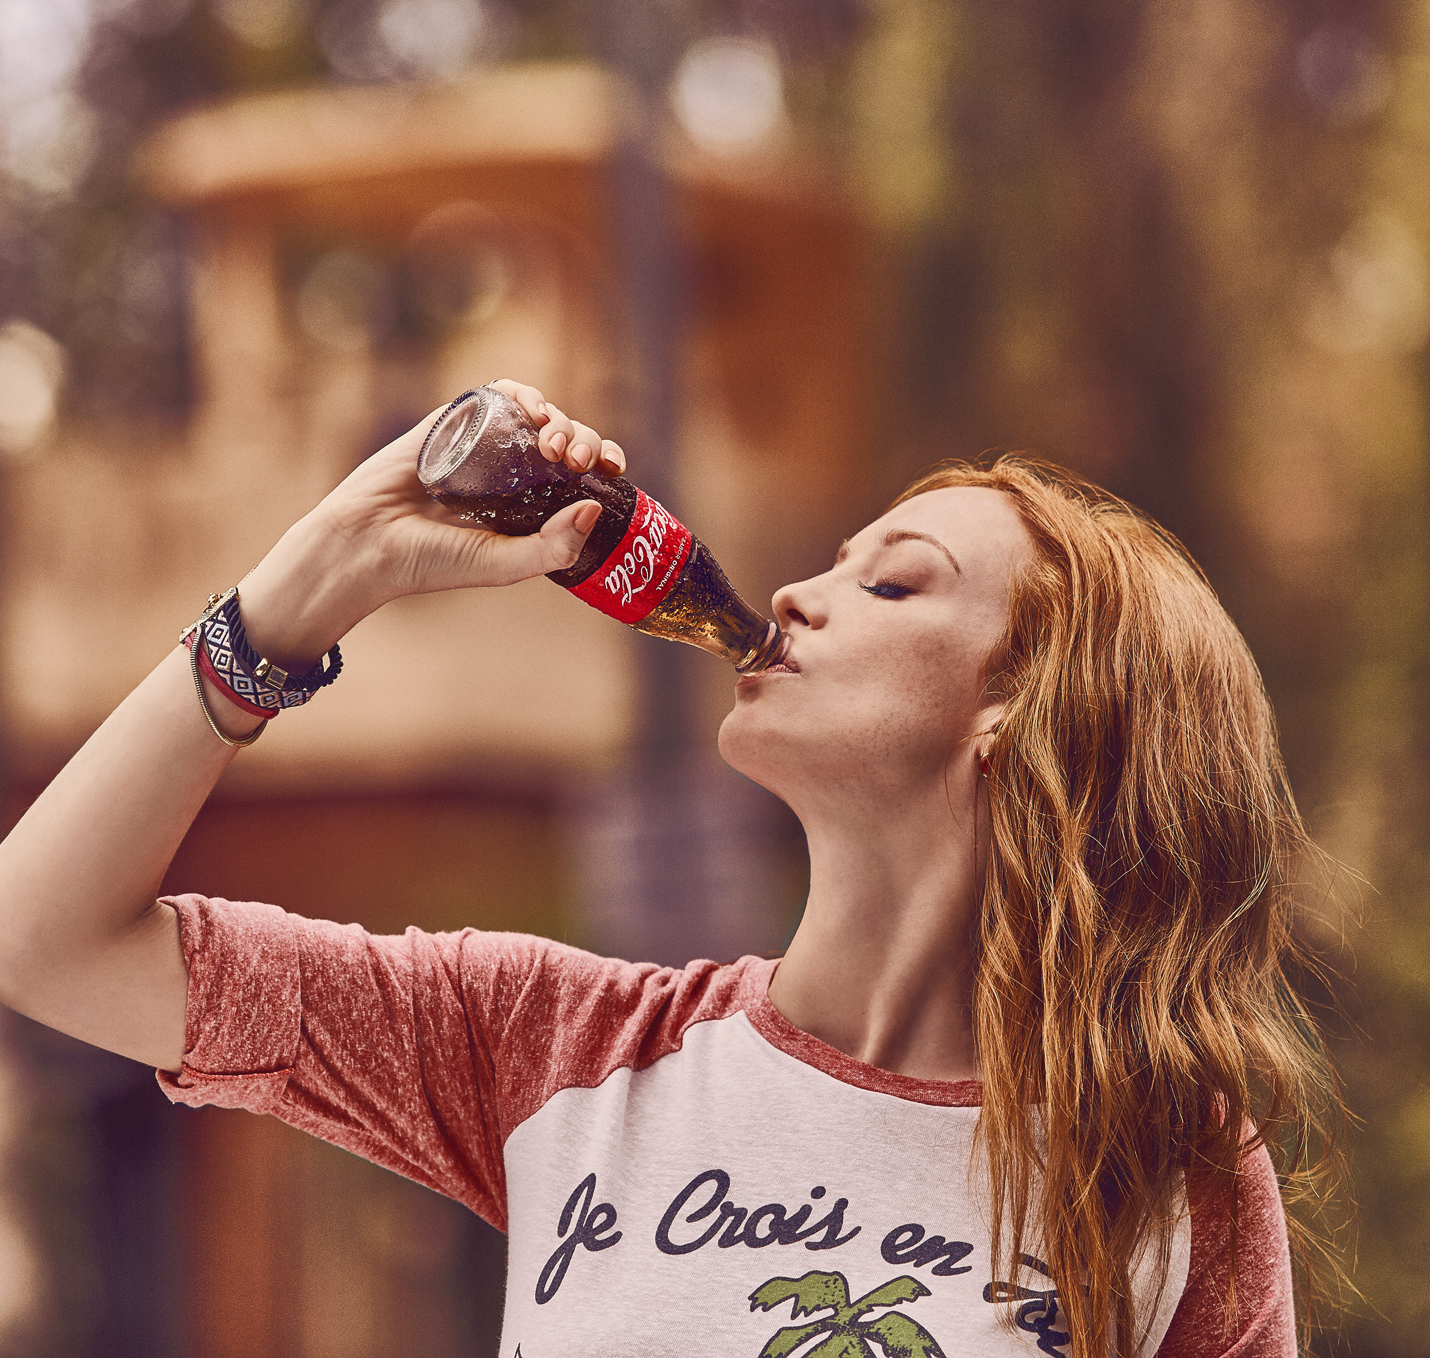
Returnables play a strategic role
in our Portfolio and Business
Returnables are the vehicle to ensure affordability and allow us to connect with low SEL
OBPPC strategy with a clear Returnables roles boost habit development by reaching more consumer & shopper needs
Segmented returnables allows to Maximize Revenue generation with one way packages
Glass Bottles with a premium role in IC Channels

Slide 16

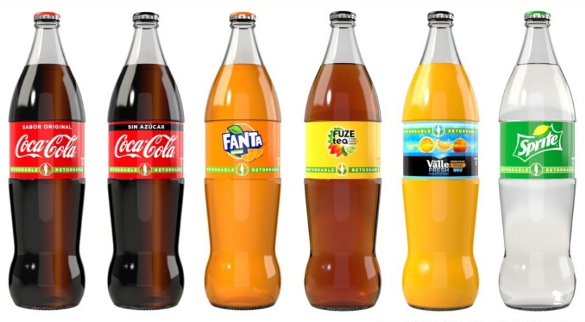
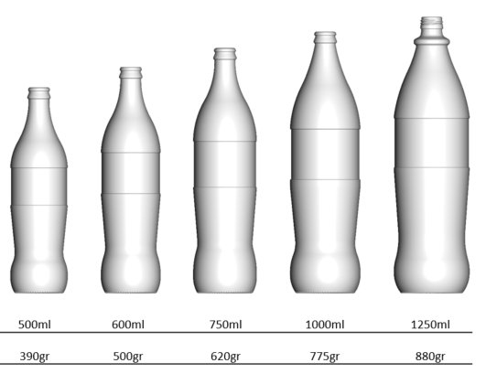
A new Returnable Bottle Family
Is ready to deploy
  RGB MS Universal Bottle
Cylindrical Panel with 3 contact points
Reduced scuffing
Aggressive lightweight
Enables labeling

Slide 17
State of the art Execution
Appealing and call to action Communication
Outstanding
Experience

Slide 18
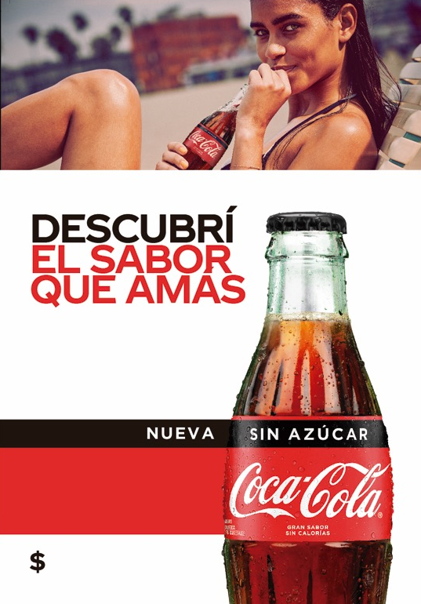
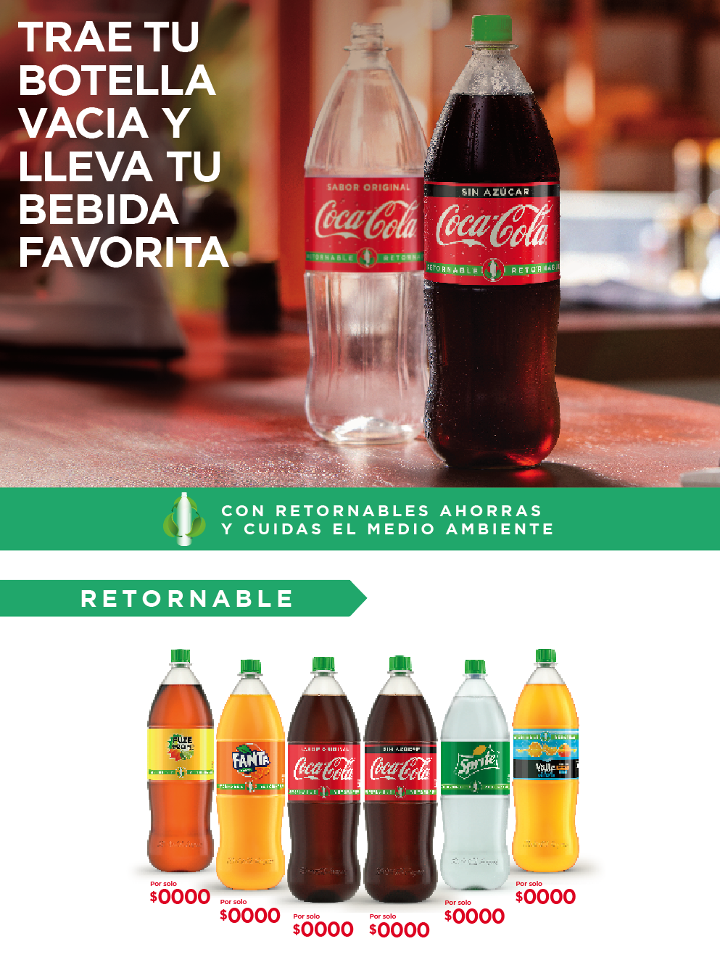
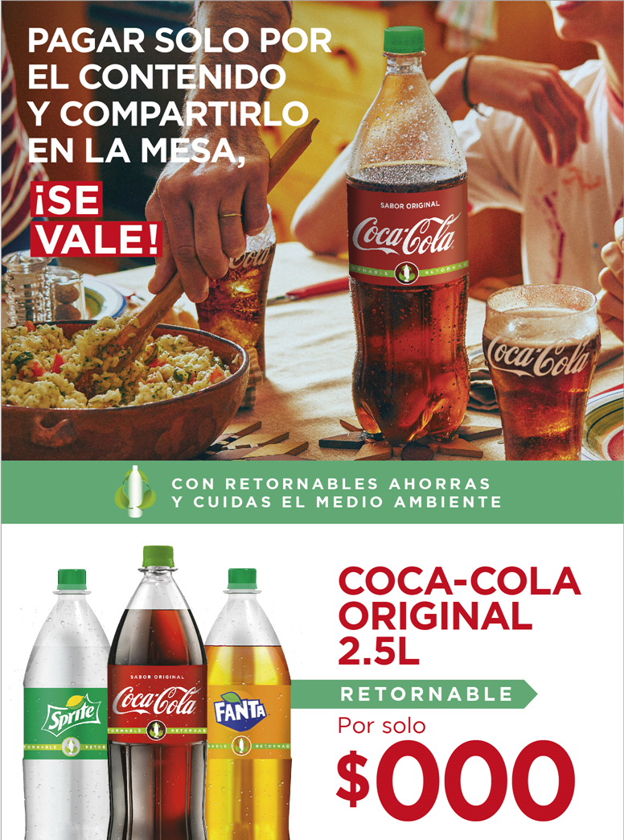
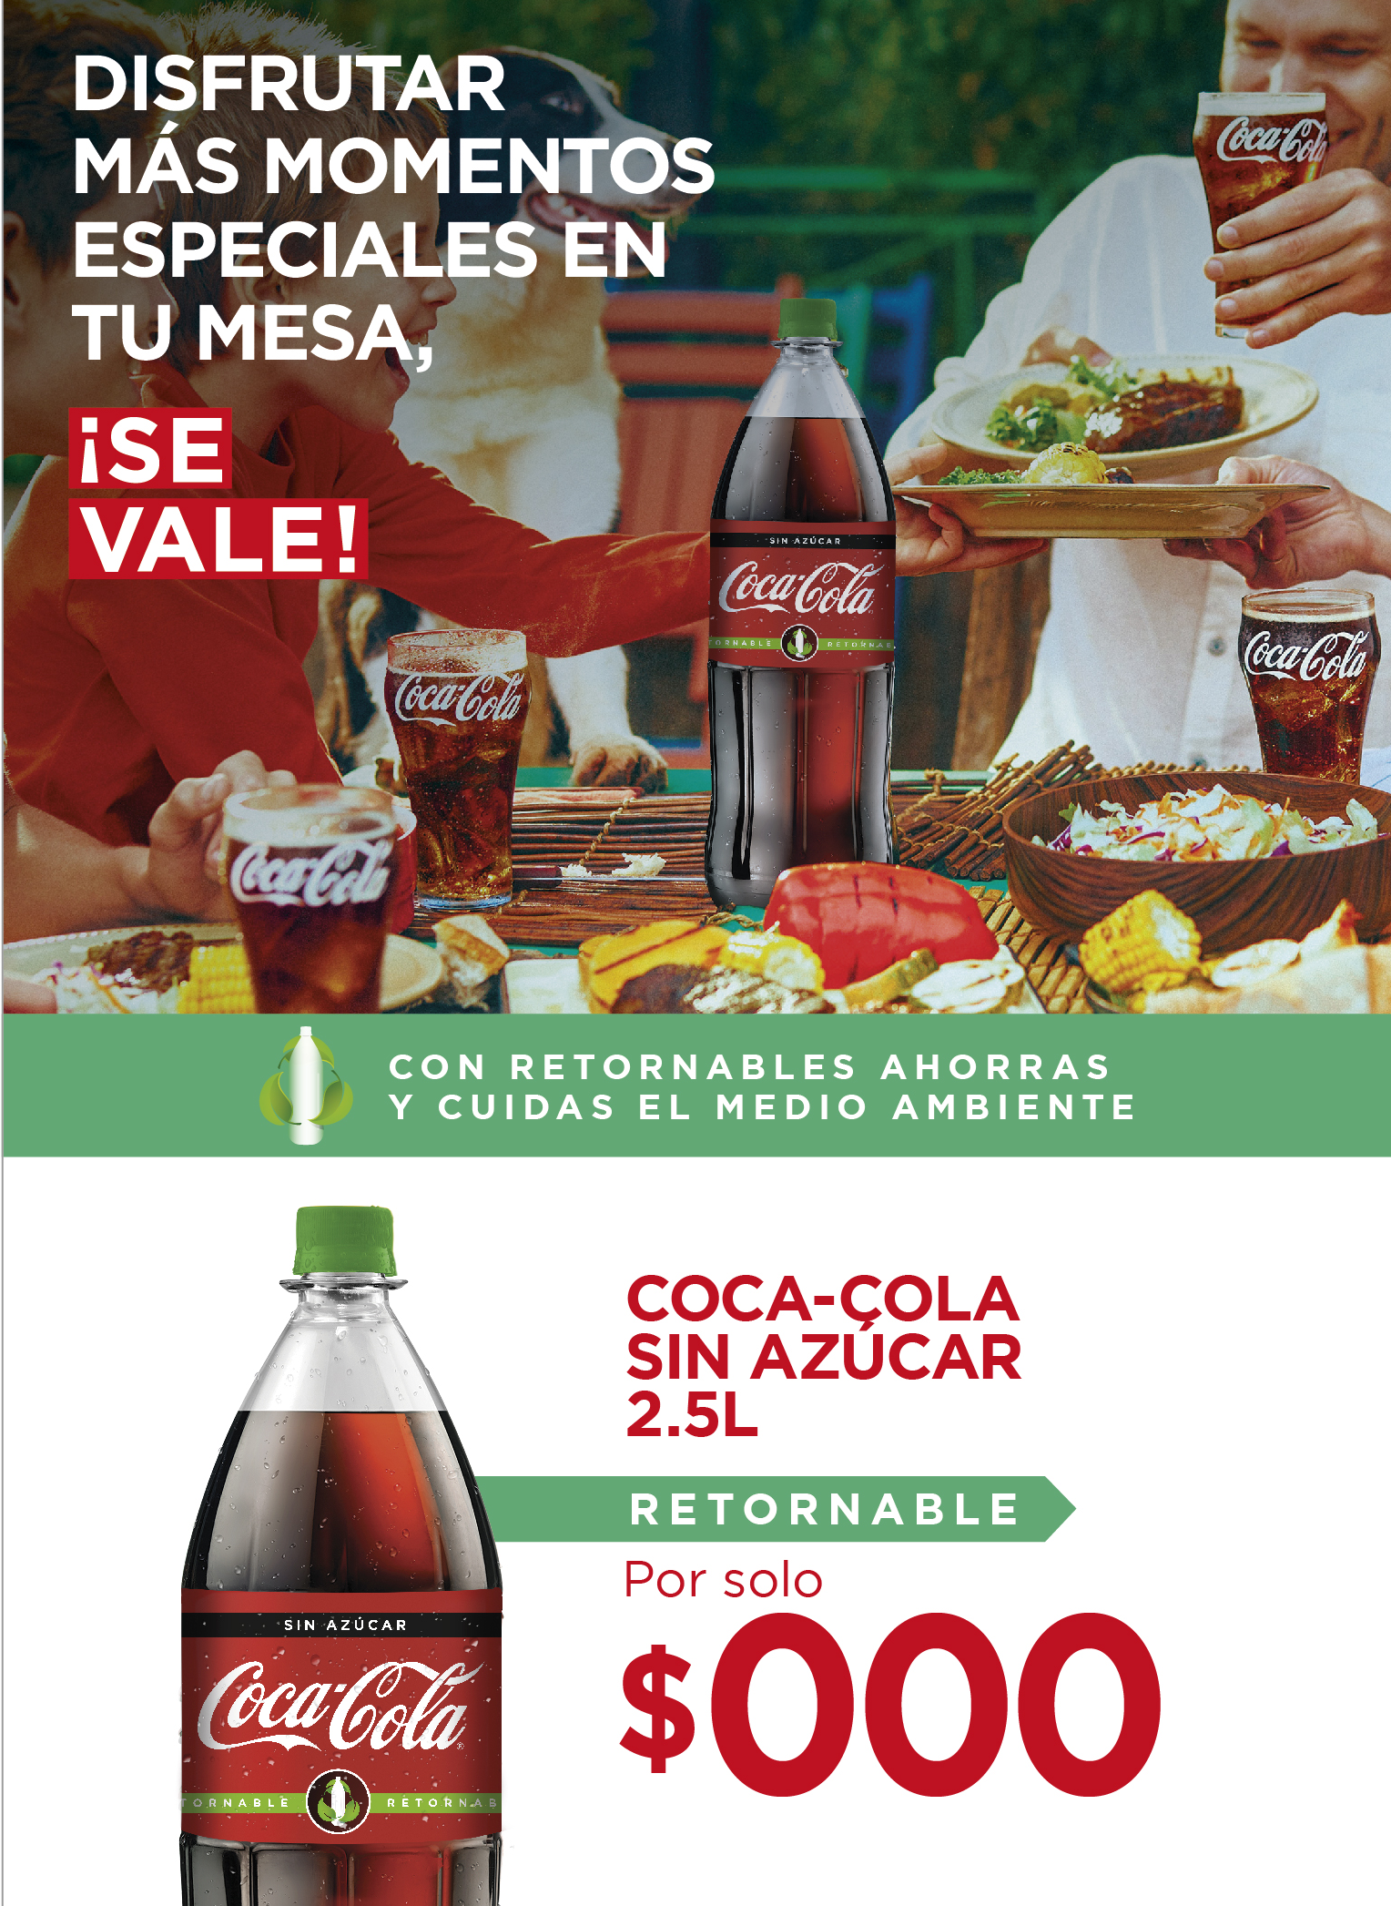
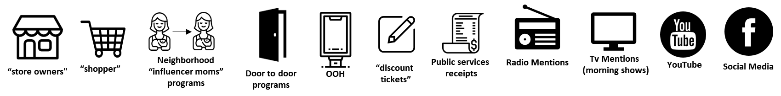

Engaging consumer through
proper connection strategy
SS consumption
Build Habit
Penetration
Frequency
*BRING YOUR BOTTLE AND TAKE YOUR FAVORITE BEVERAGE
*PAY ONLY FOR THE CONTENT AND SHARE IN THE TABLE
*ENJOY SPECIAL MOMENTS IN THE TABLE
DISCOVER
With the right
Messages
THE FLAVOR
YOU LOVE
* WITH RETURNABLES YOU SAVE AND TAKE CARE OF THE ENVIRONMENT
…and Right
Connection Points and moments

Slide 19

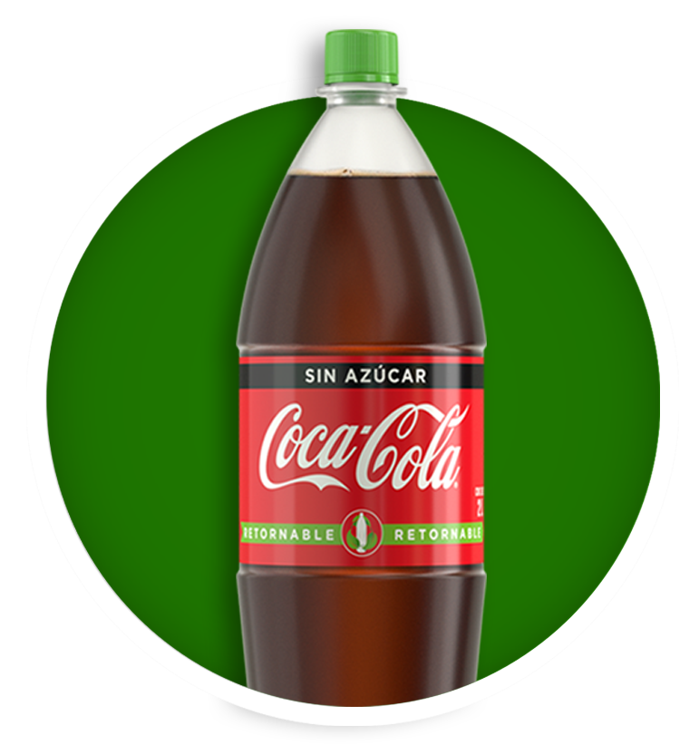
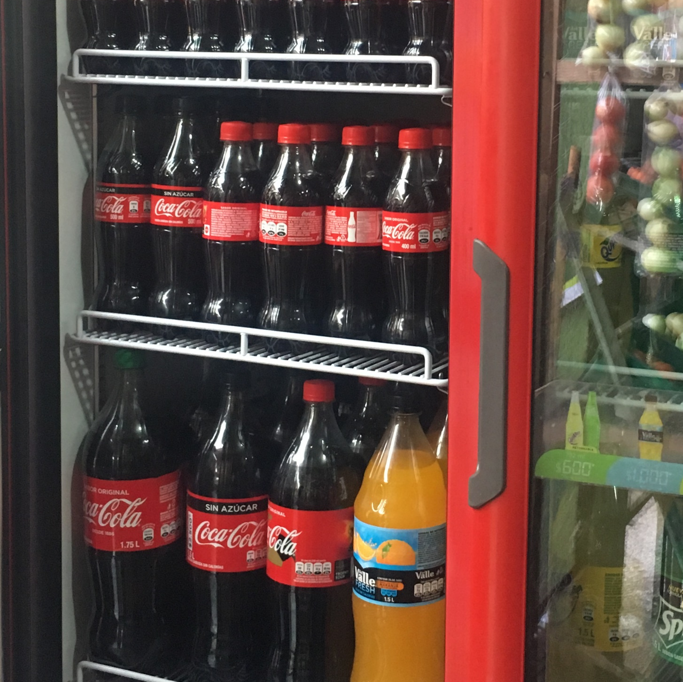


…will generate Returnable’s Execution EDGE
& improve our Quality Leadership
Availability
Improve profit - margins
Sales - Transactions
SOVI & SOCI
Returnables’ EDGE
Volume
Revenue
Profit
Share of Market
Share of Value
CDE/10k hab
Items per store
Increase consumer base
Relevance
POS Experience
ReturnablesPortfolio Availability
Cooler Coverage and Execution
Brand love
Dailies conversion
Per Caps increase
Better experience
Uniqueness

Slide 20
Build & reinforce the returnable habit through fully integrated 360 Plans for all stakeholders
Full
Engagement

Slide 21
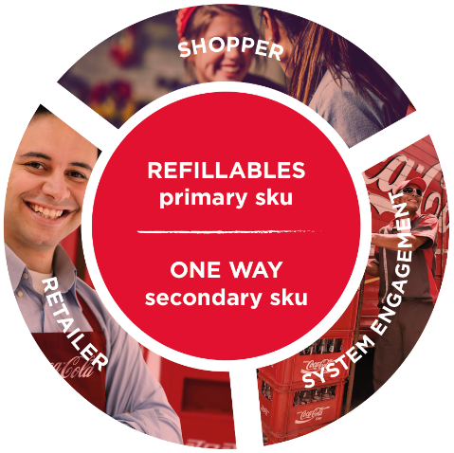
Engaging all players through
a full 360° returnable and affordability plan
Shoppers
Outstanding Communication and Promotional Platform for RET PicOS at POS
Retailers
Introducing a 4-tier plan:
Retailer Incentives
Loyalty programs
Visibility Drive
Training
360º
System Engagement
Motivating Sales & Distribution Teams
Sales force incentives
Distribution awards
Training
Tools
Trade MKT
Increase Transactions
Increase Profit
Notes:
.

Slide 22
THANK YOU.

